Slide 1


Night Watch

Slide 2




Members
Marku
Frontend Developer
Hai
iOS Developer
Max
Designer
Rosalie
Manager
Notes:
These are our members

Slide 3
Alley
Corner
Restroom
Underpass
Park
Notes:
According to Health promotion Administration , about 15,000 sex crimes occur every year. Especially at night, when children or women walking on
Sex Crimes is likely to occur.

Slide 4
Sex Crimes
happened frequently

Slide 5
Prevention is better than cure
?
Notes:
So, The government also proposed corresponding methods, like 113 , SMS report , Emergency call 110 . But These methods have one thing in common, they only can handle events after accidents happened, but not to prevent. Everybody knows Prevention is better than cure.
But how to do?

Slide 6

TRANSPARENT
GOVERNANCE
To assist local governments to
achieve an effective reduction
in the rate of sex crimes
Notes:
This is the problem we want to solve. To assist local governments to achieve an effective reduction
in the rate of sex crimes.

Slide 7
Open Data
Data Taipei - Sex Crime Hotspots
Data Gov Tw - Sex Crime Higher likelihood Hotspots
Notes:
We use these open data
sex crime hotspots from data taipei and data Gov tw

Slide 8

APP
Notes:
Knight watch have two sides, app side and web side. the app is provide for child and women. the web is provide for police.

Slide 9
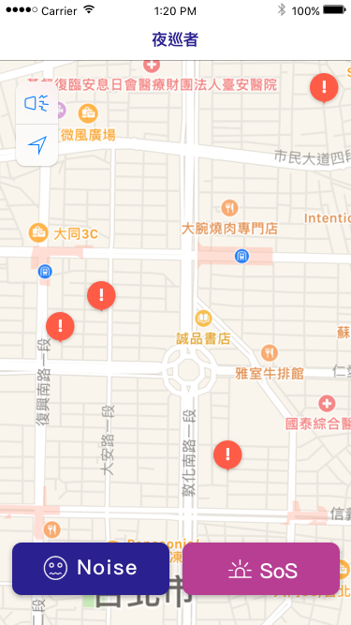
Hot Spot
Warning
Make Noise to
Attract Attention
Send a
Distress Signal
Notes:
In the app, the user can see sex crime hotspots on the map. And Two button for you to deal with accidents.

Slide 10
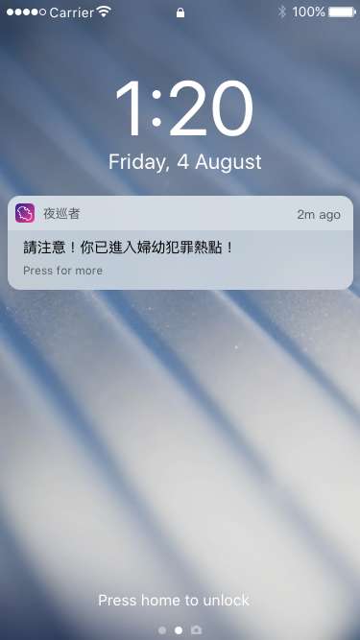
Enter Hotspots
Push Notification
Notes:
When user Enter the hotsopts zone , mobile will push notification to you even the app is run in the bk

Slide 11
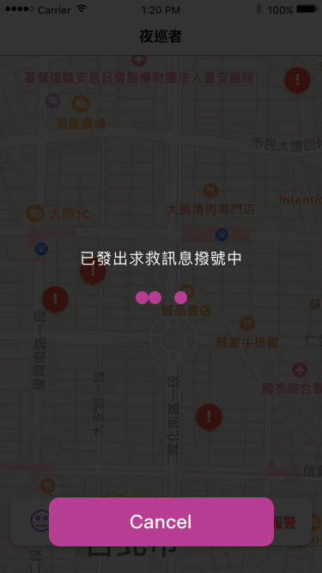
Calling for Help
Notes:
After press SoS btn , the app will direct link to web side to notice police you are in danger.

Slide 12

WEB
Notes:
In the web

Slide 13
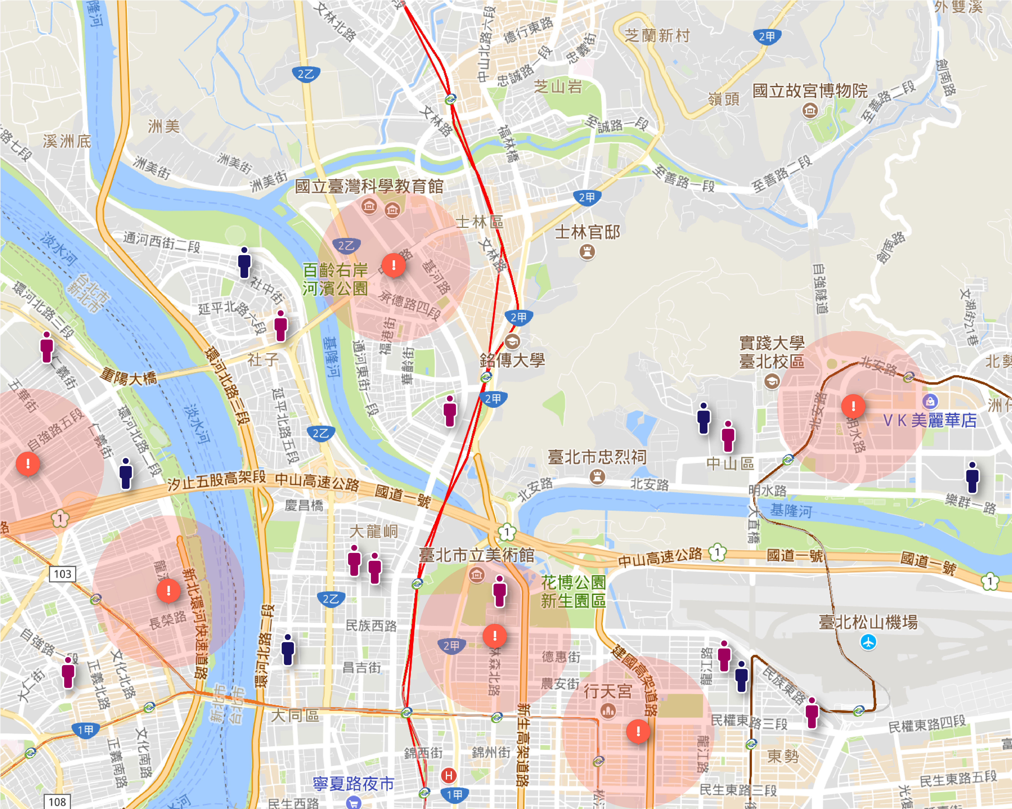

SoS Signal
User Gender
HotSpot Range
Notes:
The police can see users location and user’s gender, also can detect when users enter hotspots zone. When user press SoS button in the app. They can see the user blinking on the map.

Slide 14
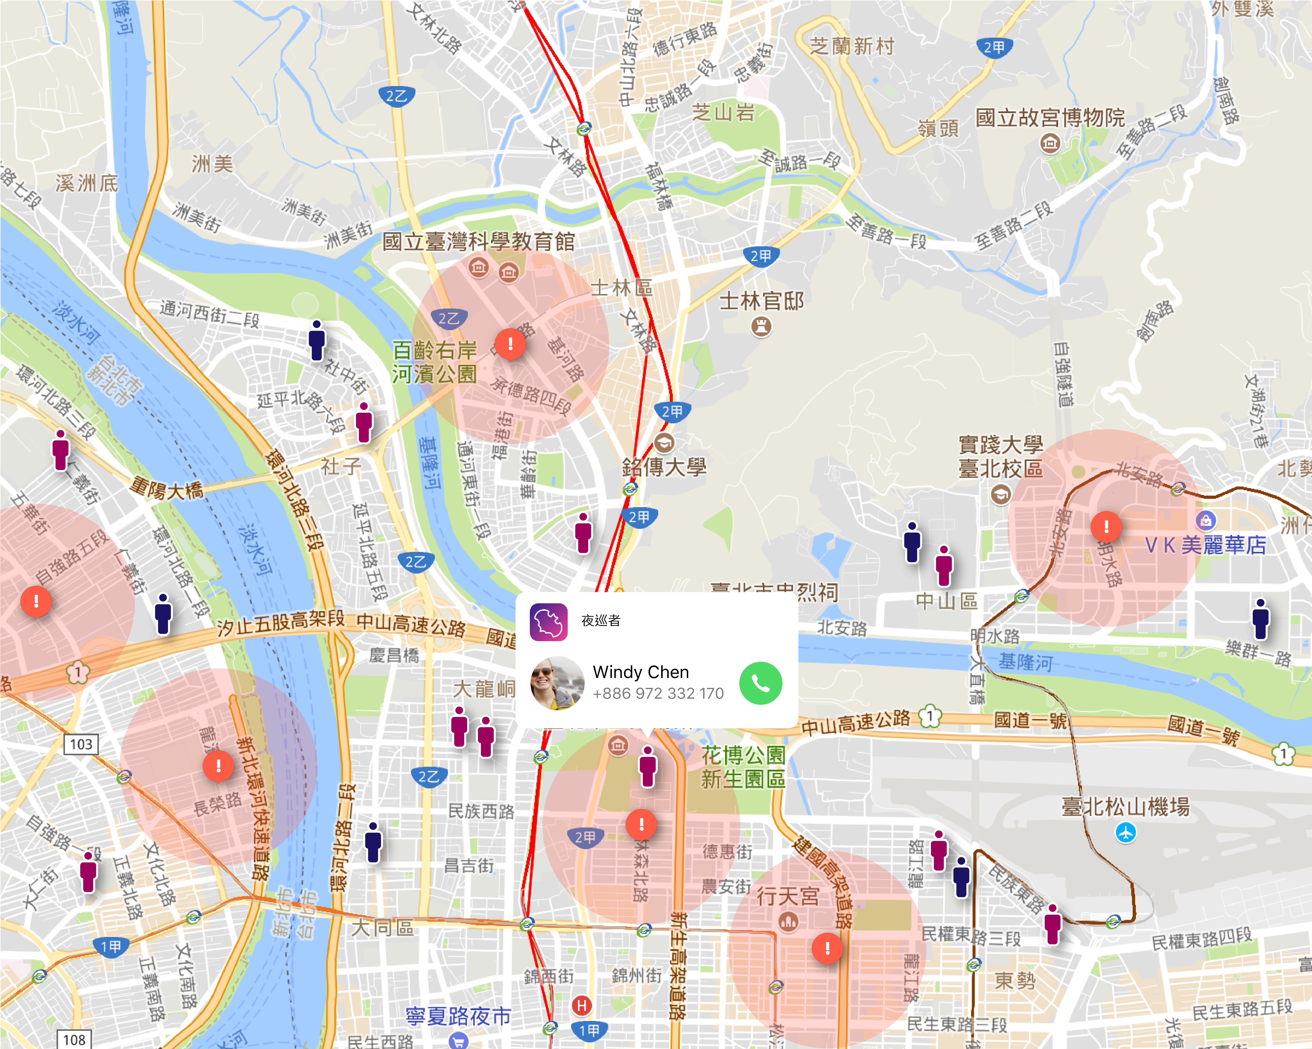
User Info
And
Contact
Notes:
Addtionally, the police can see the user’s info by click on the pin and contact them directly .

Slide 15
Live Demo

Slide 16
Notes:
People always want to predict crimes just like movie Minority Report. But we don’t have Alice.
So how to do?

Slide 17
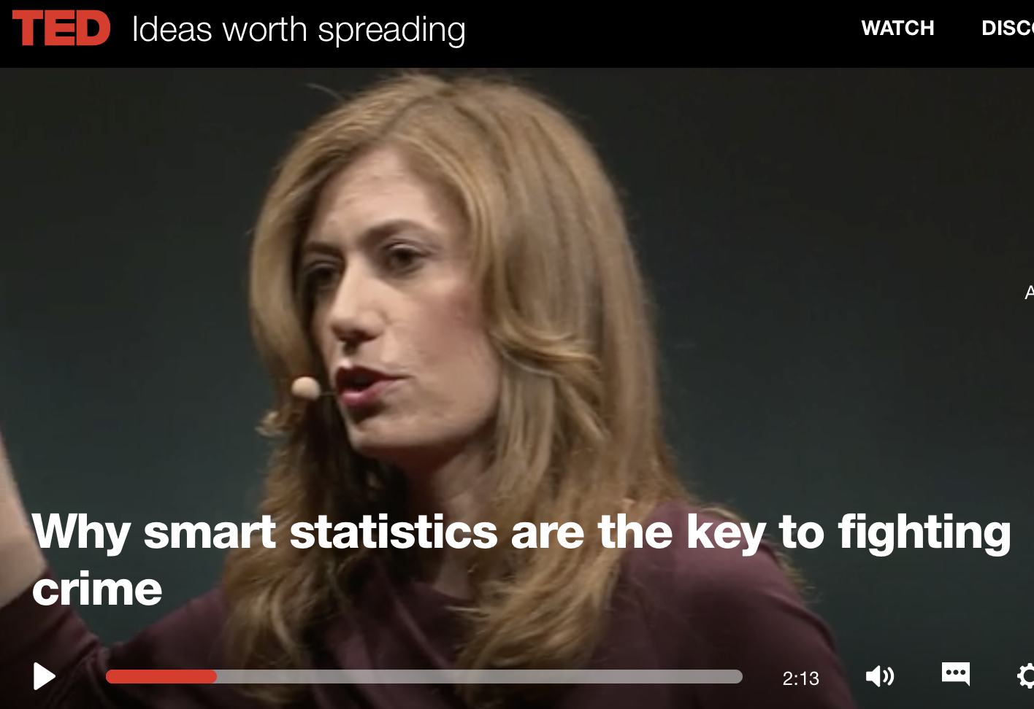
Notes:
There is a ted talk by attorney anne milgram, she mention this issue

Slide 18
Crime
Use Data to make more Data
Predict by Data
Take Action after Predict to realize truly crime Prevention
Notes:
This is what we want to do
We will gather all user data from our system, includes users location/accident happen places/and flow of people.

Slide 19
In the Future
Applied in various types of crimes
Use machine learning technology with hotspots to predict hotspots

Slide 20
Night gathers,
and now our watch begins.

Slide 21


